Slide 1
Unique Entity Estimation with Application to the Syrian Conflict
Beidi Chen*, Anshumali Shrivastava*, Rebecca C. Steorts†

Slide 2
Motivation
Estimate Syrian Conflict Casualties across datasets from different sources.
Future transitional justice and accountability measures

Slide 3
Motivation

Slide 4
Problem
Given a dataset of M records, estimate the number of distinct identities (records) n < M.
Unique Entity Estimation (UEE)
Example:

Slide 5
Difficulties
Data Duplications: Aggregate from various resources
Data Noises: Human Error/ Bias
Lack of Labels: Records in Arabic
Computational Challenges:
300, 000 records

Slide 6
Possible Approaches
Why not simply compare every two records?
O(M²) ~ 4.5X10¹⁰ Pairs, 6 days (Syrian Dataset)
Sensitive to noise
We can get a good in 119 Seconds

Slide 7
Possible Approaches
Put similar records into blocks or bins
Sacrifice accuracy for efficiency
No Statistical Guarantees (Systematic Bias)

Slide 8
Approach
Pure random sampling for UEE:
Mapping
Estimate the # of Connected Components

Slide 9
Approach
Random Sampling:
All individuals in population has an equal chance to be selected.
Example:

Slide 10
Issues
Fix budge: s pairwise comparisons

Slide 11
Approach
Adaptive Sampling?
Sampled based on similarity of the vertex pair
Assumption: Duplicates are likely to be similar in textual attributes. Note we do not assume any fixed threshold.

Slide 12
Issues
Need computation of pairwise similarity
(O(M²)), 6 days on Syrian Dataset

Slide 13
Approach
Is there an method for adaptive sampling based on similarity in sub quadratic time?
Locality Sensitive Hashing

Slide 14
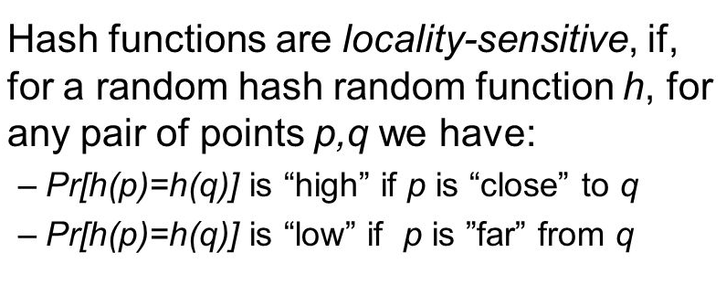
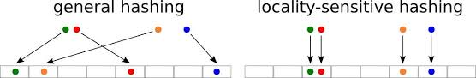
LSH
Locality Sensitive Hashing

Slide 15
LSH
Benefits:
Adaptive Sampling (mentioned before)
Randomness compared to blocking
The selected pairs will not be the same
Probability guarantees

Slide 16
What we get?
A sub-quadratic process samples a small set of edges S that, every edge in the original graph G∗ has (reasonably high) probability of being in S.
p=0.75

Slide 17
Process

Slide 18
Method
Estimator: LSHE

Slide 19
Estimator

Slide 20
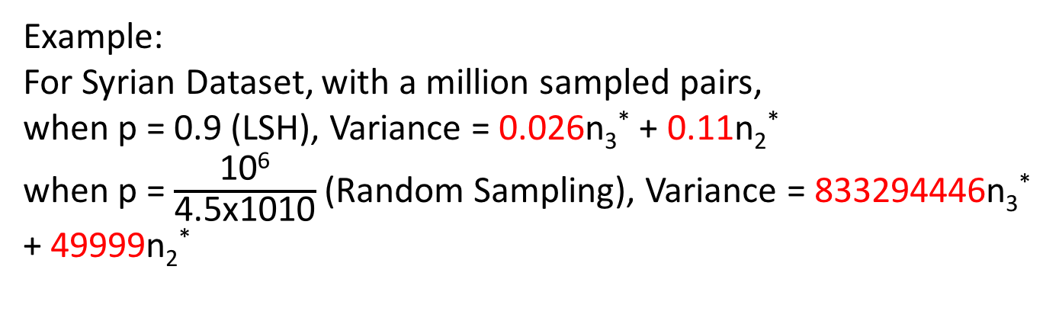
Estimator Properties
Variance is monotonically decreasing when p increases
Example:
For Syrian Dataset, with a million sampled pairs,
when p = 0.9 (LSH), Variance = 0.026n₃* + 0.11n₂*
when p = $\frac{\text{10}\text{6}}{\text{4.5}\text{x}\text{1010}}$ (Random Sampling), Variance = 833294446n₃* + 49999n₂*

Slide 21
Experiments

Slide 22
Results

Slide 23
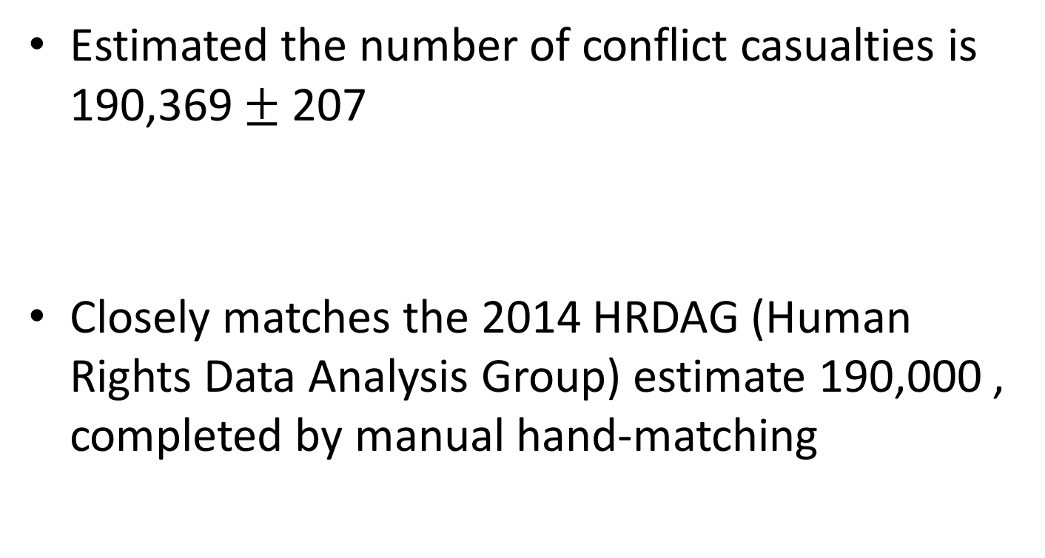
Result
Estimated the number of conflict casualties is 190,369 $±$ 207
Closely matches the 2014 HRDAG (Human Rights Data Analysis Group) estimate 190,000 , completed by manual hand-matching

Slide 24
Conclusion
Proposed a scalable algorithm for UEE motivated by Syrian problem.
The estimator is unbiased and low variance
It is empirically tested on three real datasets
We do an estimation on Syrian Conflict Casualties

